Slide 1
Session #10 ( #11) :
On Policy Prediction with Approximation

Slide 2
Agenda for the classes
Introduction
Value Function Approximation
Stochastic Gradient, Semi-Gradient Methods
Role of Deep Learning for Function Approximation;
Feature Construction Methods

Slide 3

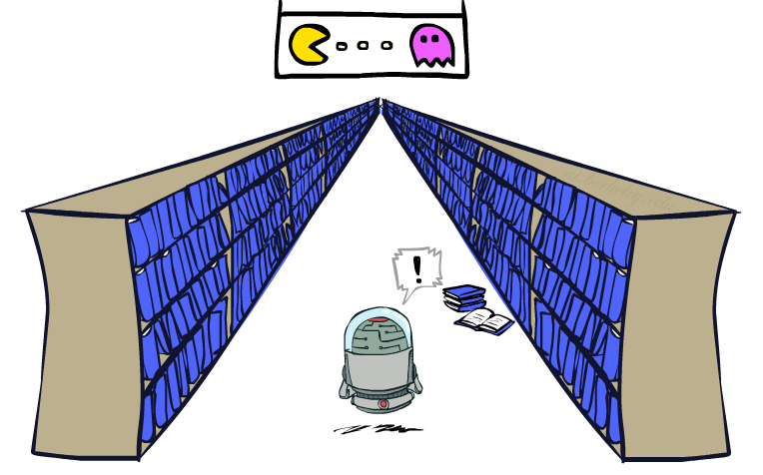
Generalizing Across States
Tabular Learning keeps a table of all state values
In realistic situations, we cannot possibly learn about every single state!
Too many states to visit them all during training
Too many states to hold a value table in memory
Instead, we want to generalize:
Learn about some small number of training states from experience
Generalize that experience to new, similar situations
This is a fundamental idea in machine learning

Slide 4
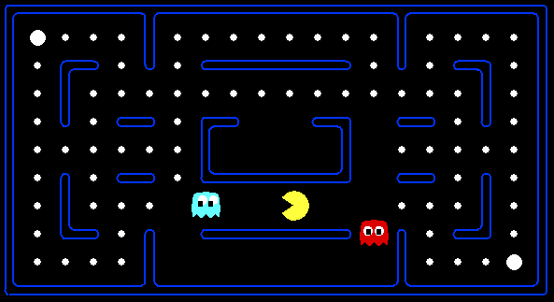



Example: Pacman
Let’s say we discover through experience that this state is bad:
In naïve tabular-learning, we know nothing about this state:
Or even this one!
Demo
Notes:
python pacman.py -p PacmanQAgent -x 50 -n 60 -l mediumGrid

Slide 5
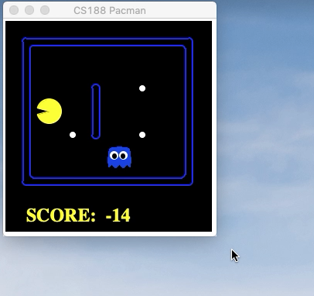
Naïve Q-learning
After 50 training episodes

Slide 6




Learn an approximation function
Learn
Predict
Generalize
Demo: python3 pacman.py -p PacmanQAgent -x 50 -n 60 -l mediumGrid ; python3 pacman.py -p ApproximateQAgent -a extractor=SimpleExtractor -x 50 -n 60 -l mediumGrid ; python3 pacman.py -p ApproximateQAgent -n 10 -l smallClassic -a numTraining=10 -a extractor=SimpleExtractor

Slide 7
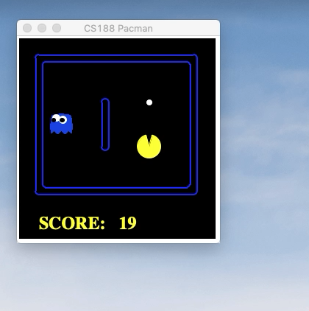
Q-learning with function approximator

Slide 8
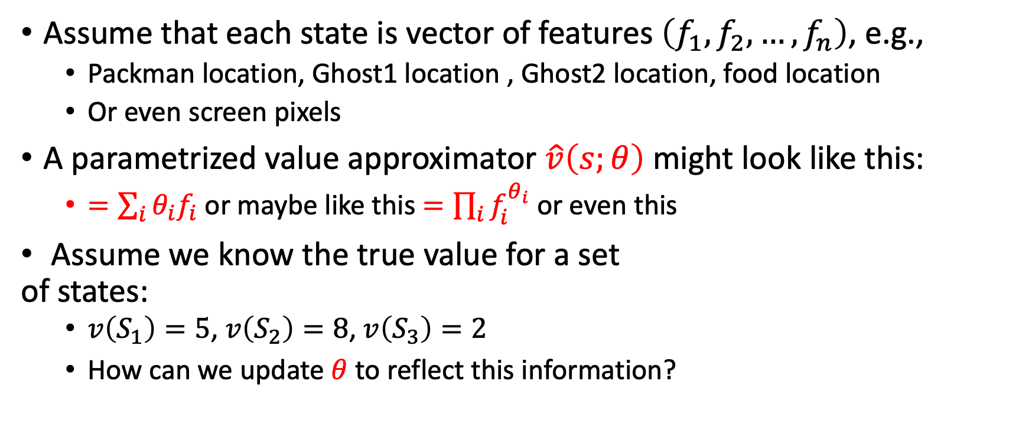


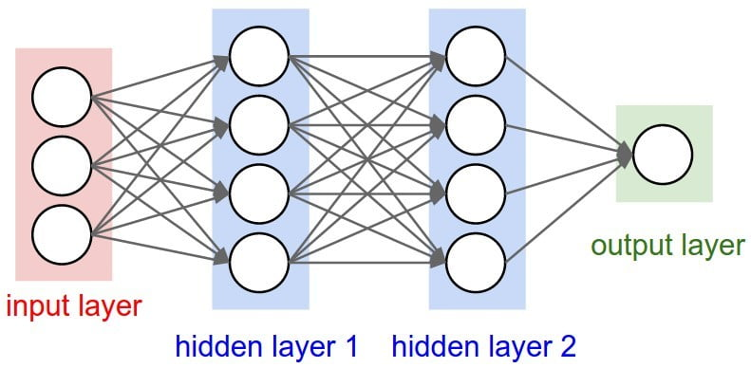





Parameterized function approximator

Slide 9
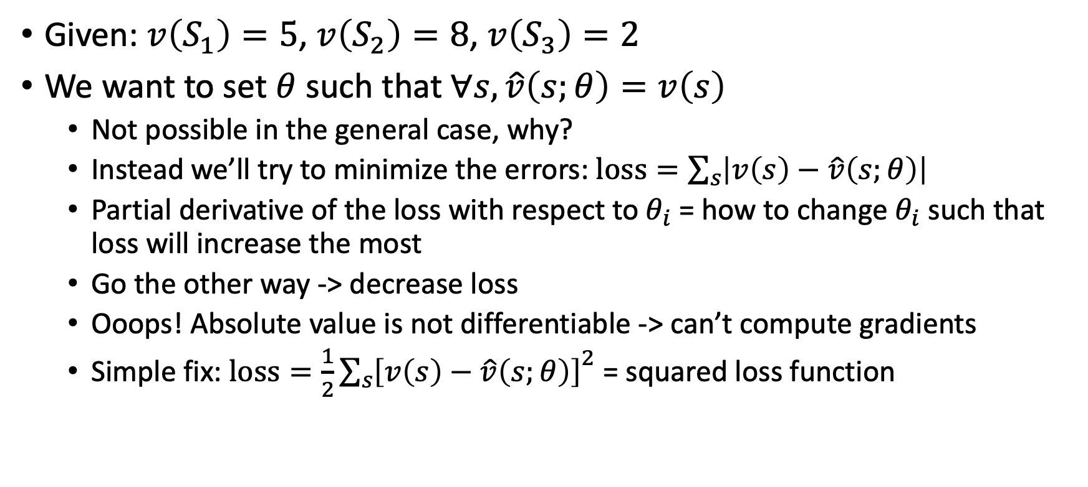
Gradient Descent

Slide 10
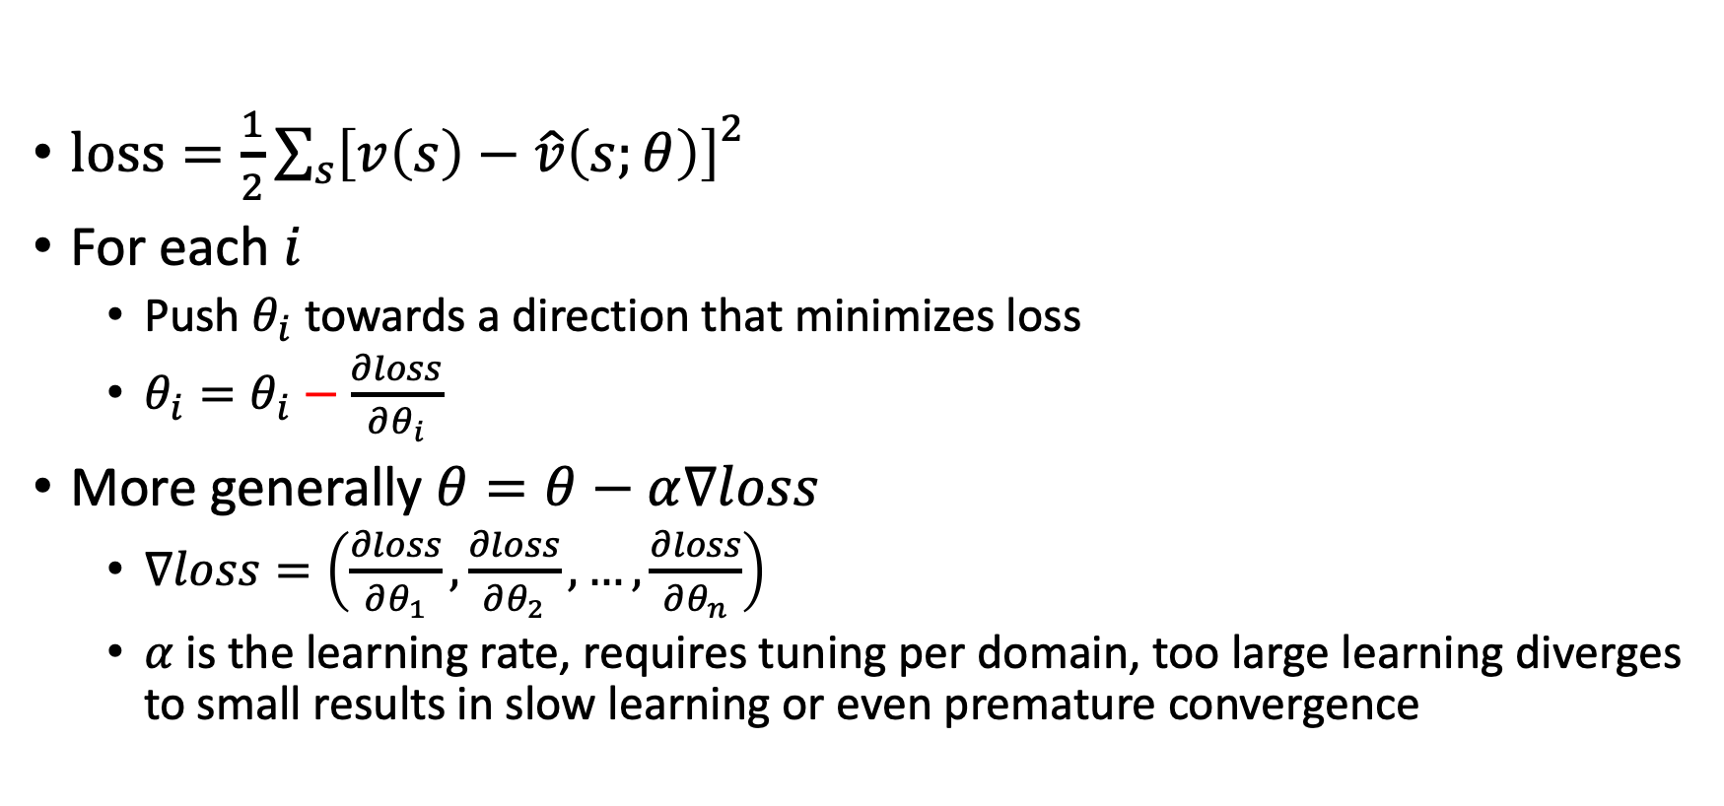
Gradient Decent

Slide 11
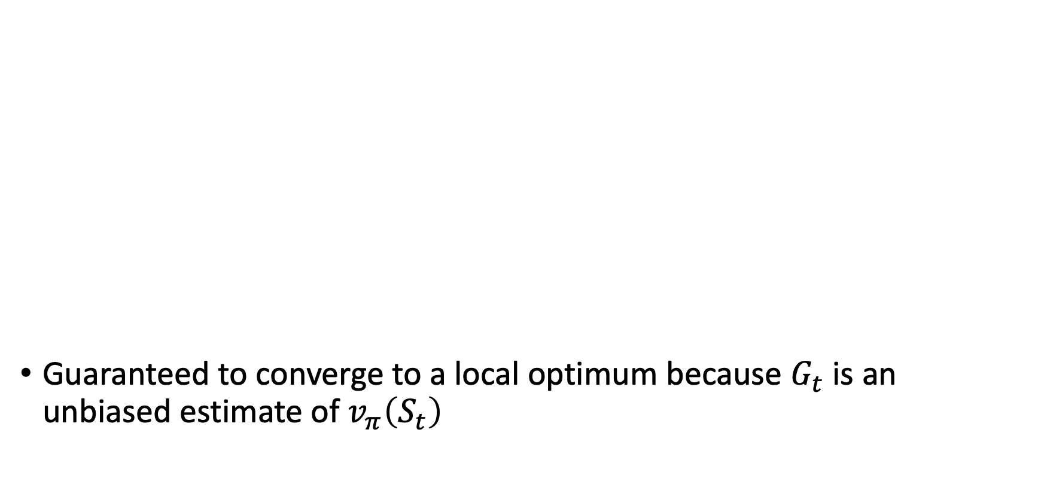
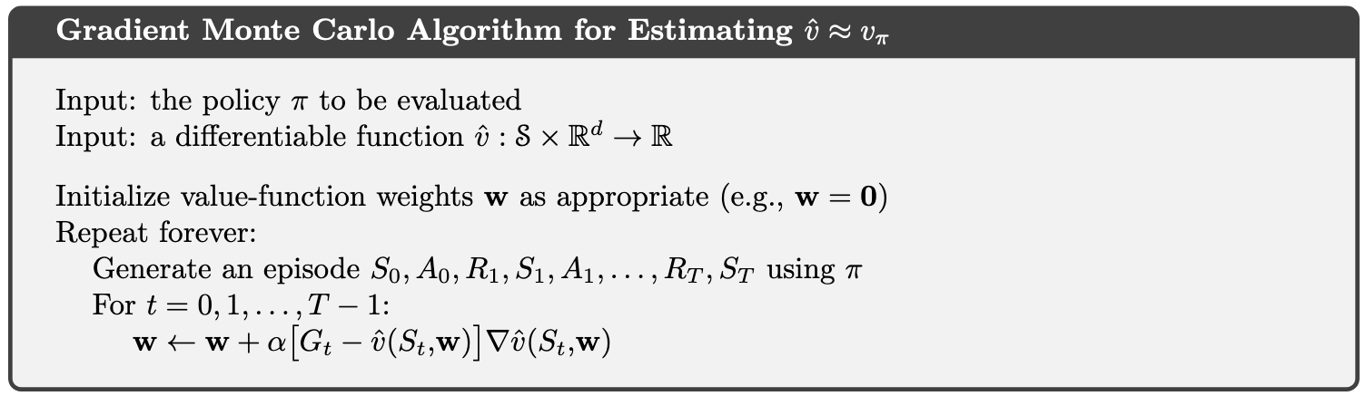
SGD for Monte Carlo estimation
w are the tunable parameters of the value approximation function

Slide 12

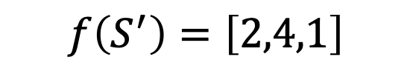
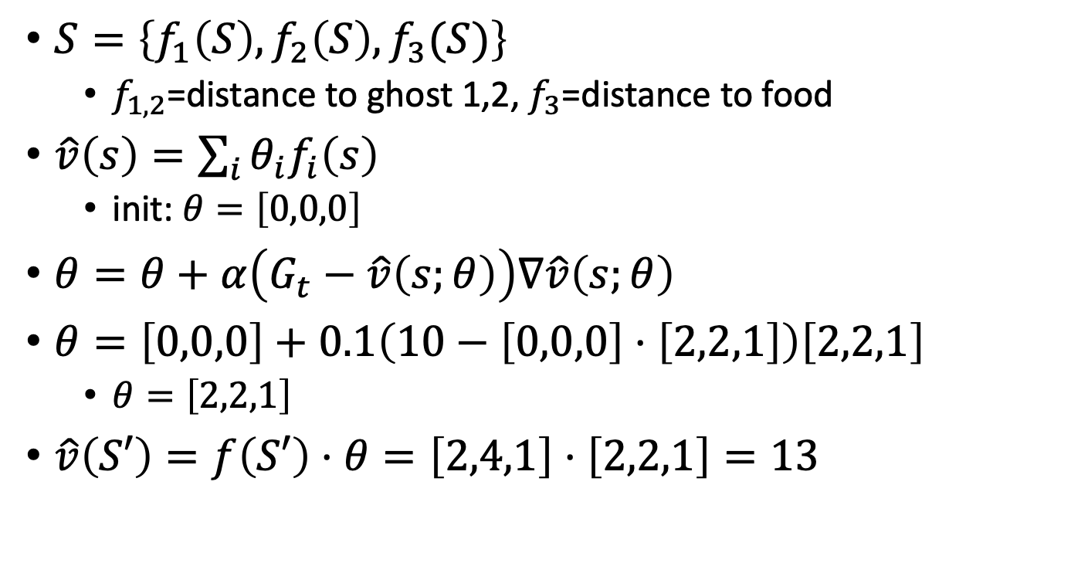
Example
10

Slide 13
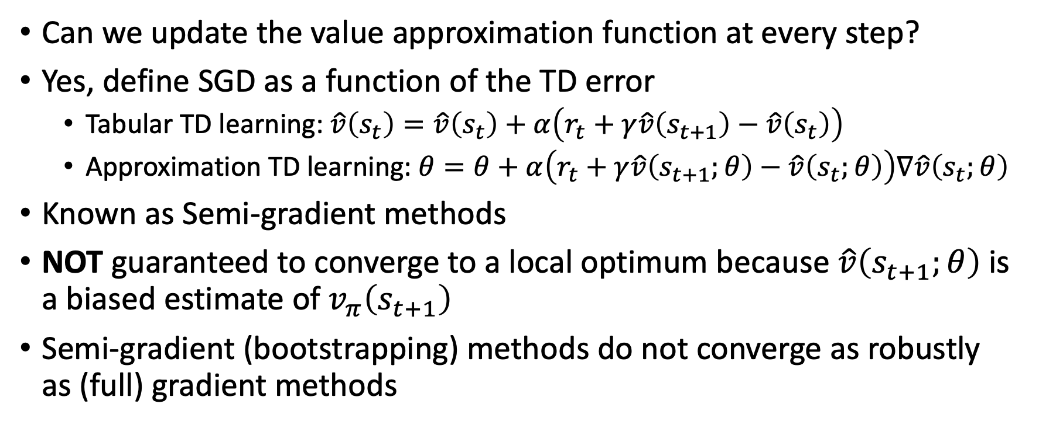
Learning approximation with bootstrapping

Slide 14
Semi-gradient methods
They do converge reliably in important cases such as the linear approximation case
They offer important advantages that make them often clearly preferred
They typically enable significantly faster learning, as we have seen in Chapters 6 and 7
They enable learning to be continual and online, without waiting for the end of an episode
This enables them to be used on continuing problems and provides computational advantages

Slide 15
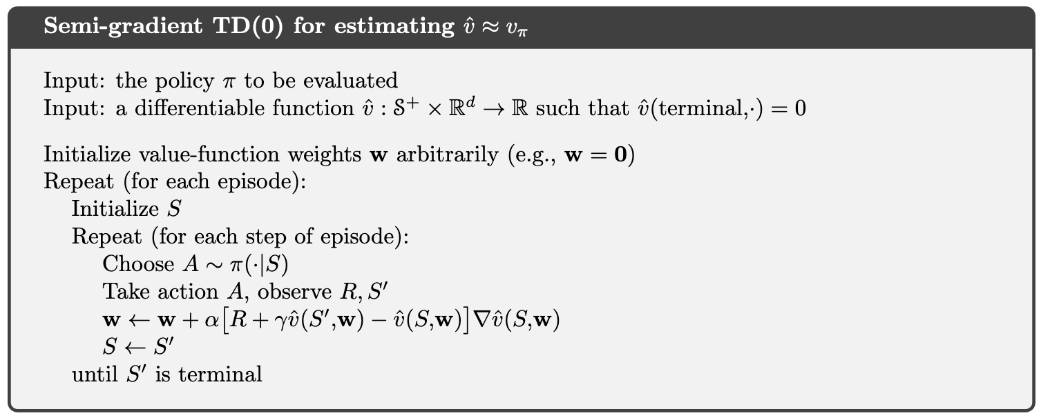
Semi-gradient TD(0)
What’s the difference from the tabular case?

Slide 16
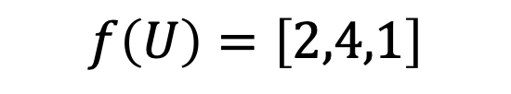

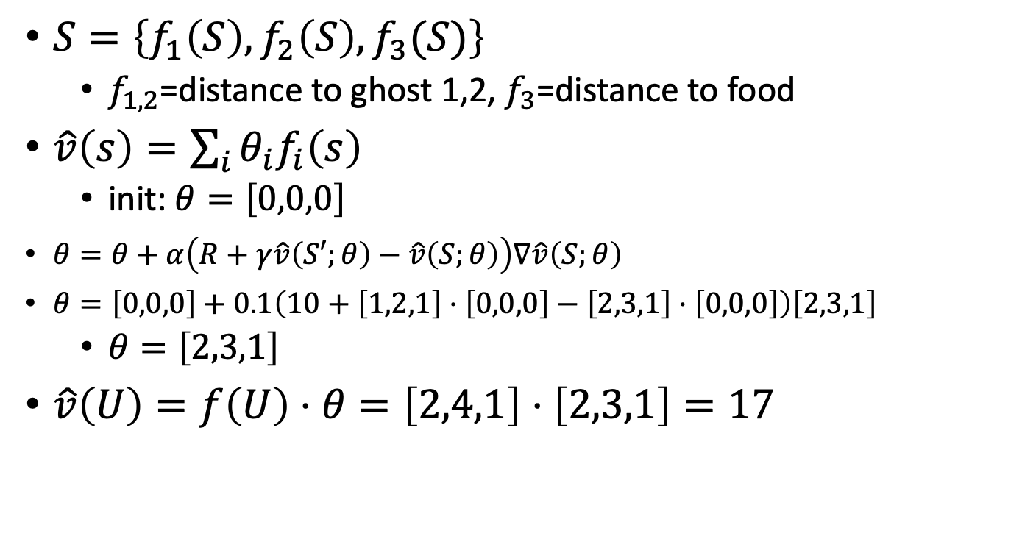


Example

Slide 17
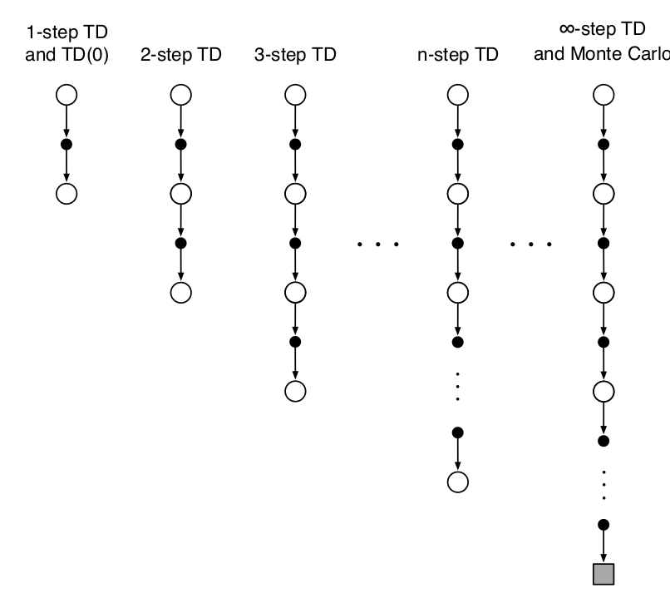


[Review] n-step TD Prediction
One-step return:
Two-step return:
Ref Section 7.1 of TB

Slide 18
[Review] n-step TD Prediction
One-step return:
Two-step return:
n-step return:
Ref Section 7.1 of TB

Slide 19
[Review] n-step TD Prediction
One-step return:
Two-step return:
n-step return:
State-value learning algorithm for using n-step returns:
Ref Section 7.1 of TB

Slide 20
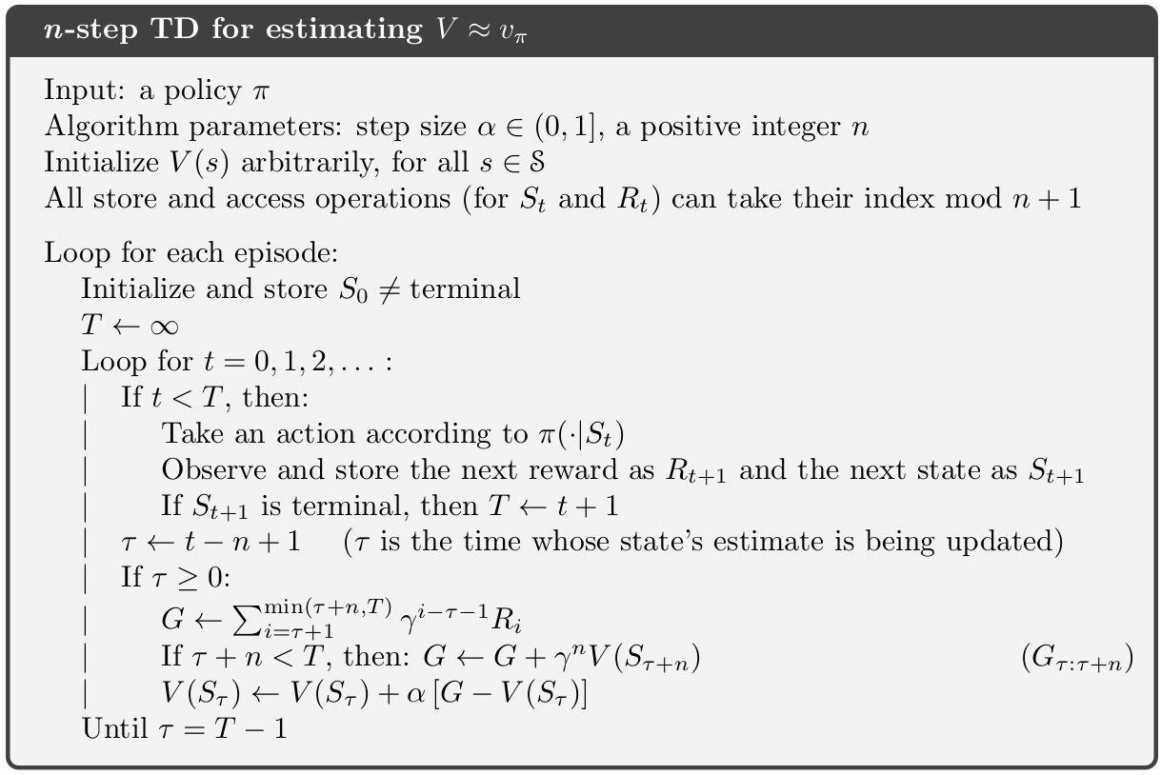
[Review] n-step TD Prediction

Slide 21
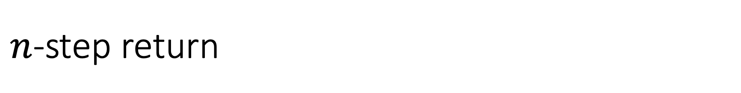
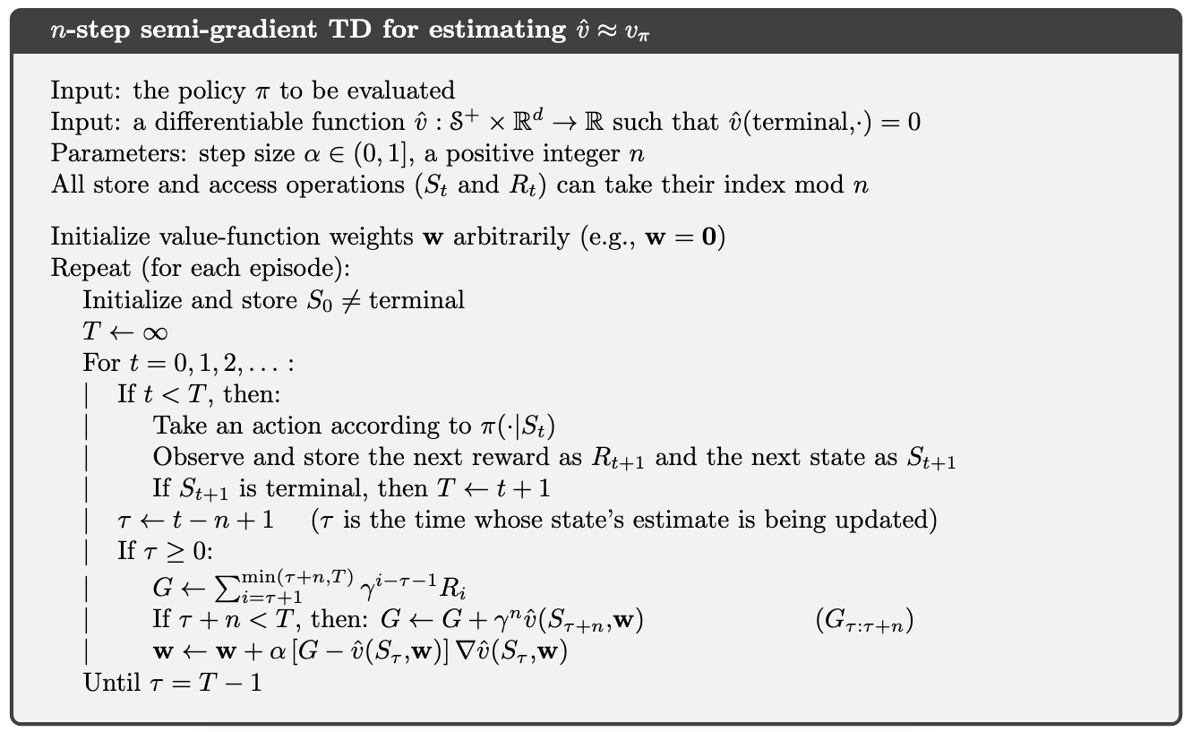
Again, only a simple modification over the tabular setting

Slide 22
Again, only a simple modification over the tabular setting
Weight update instead of tabular entry update

Slide 23

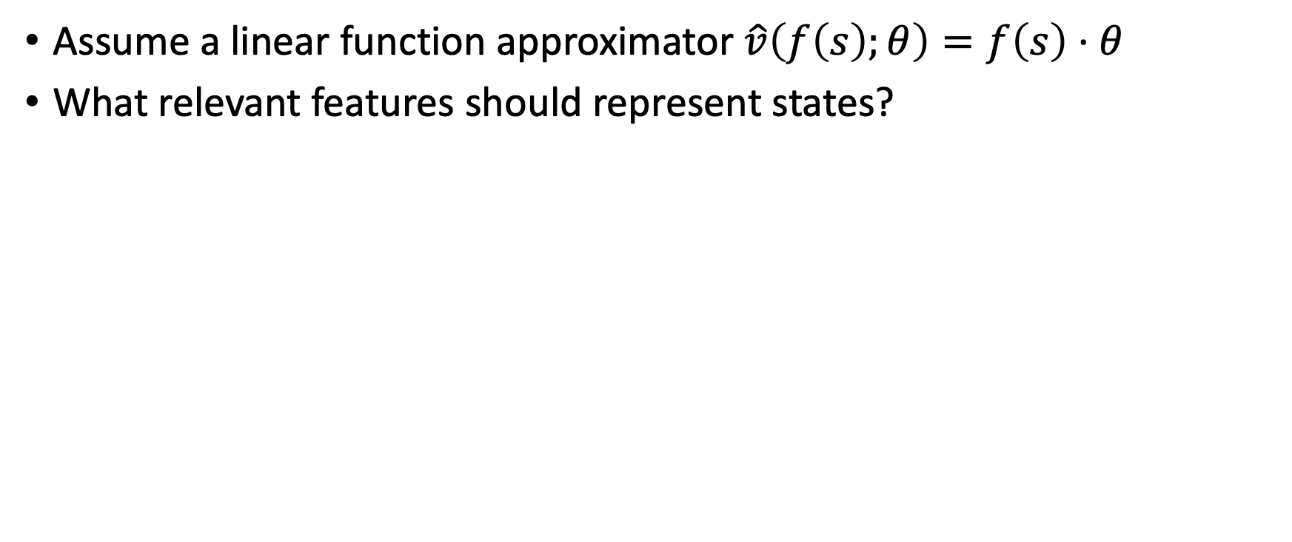
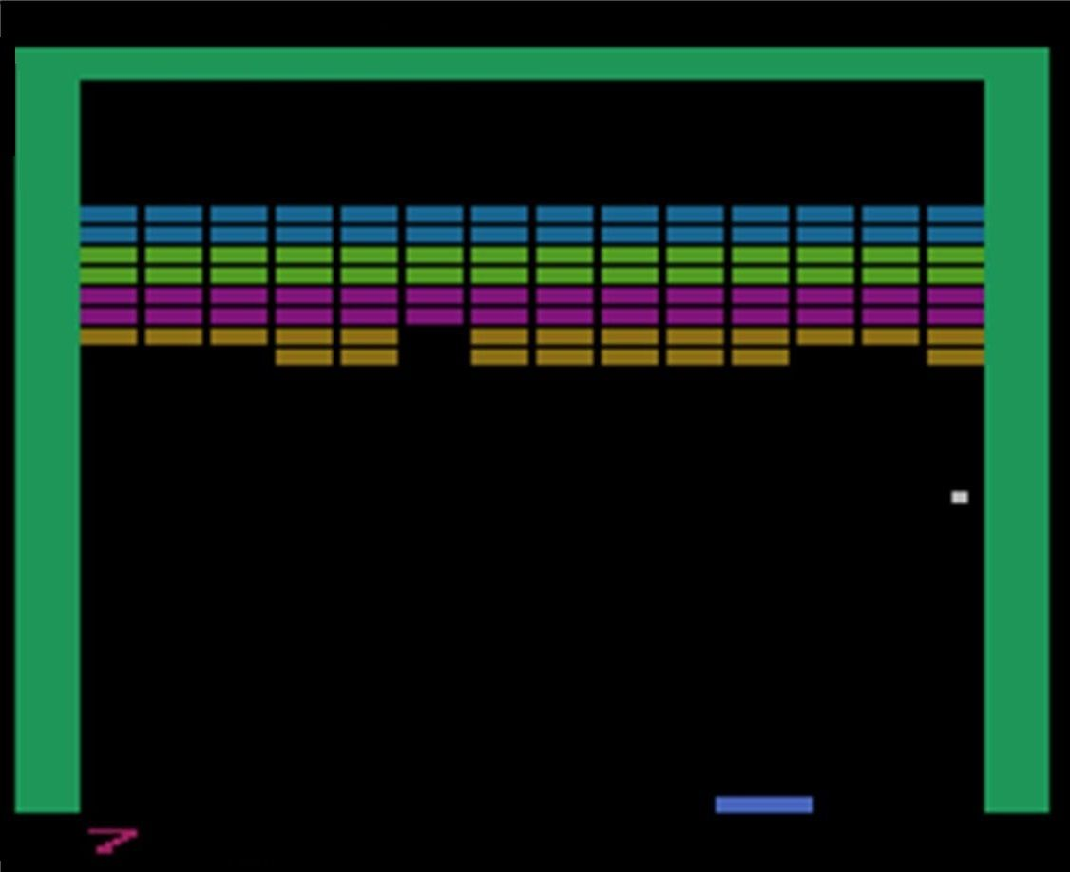

Feature selection
Features are domain depended
requiring expert knowledge

Slide 24
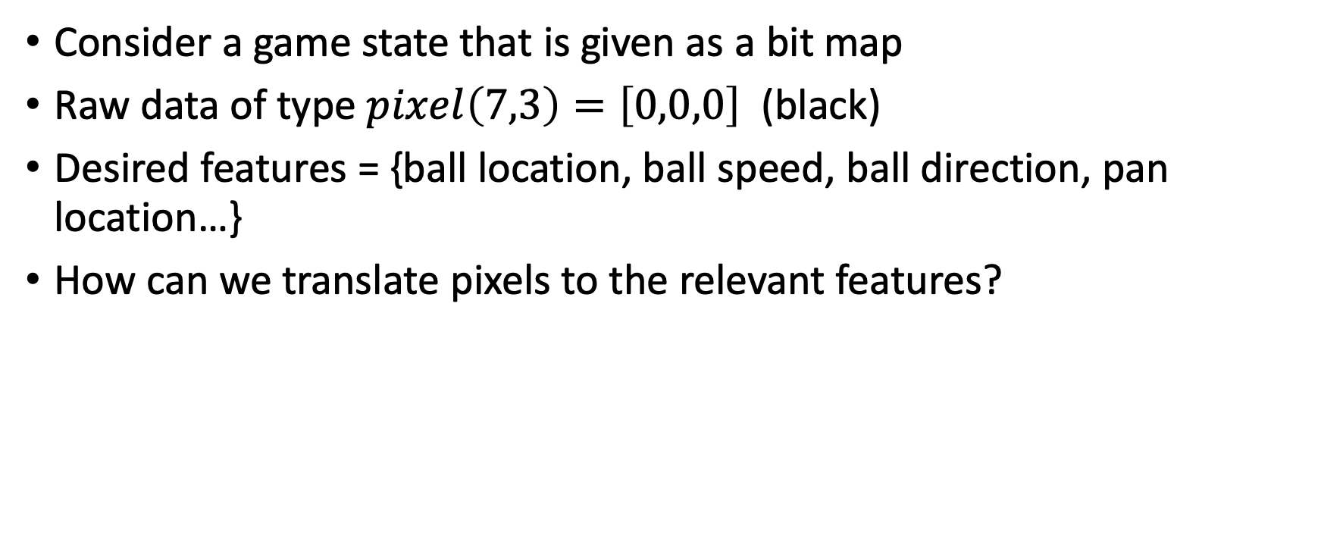
Automatic features extraction

Slide 25
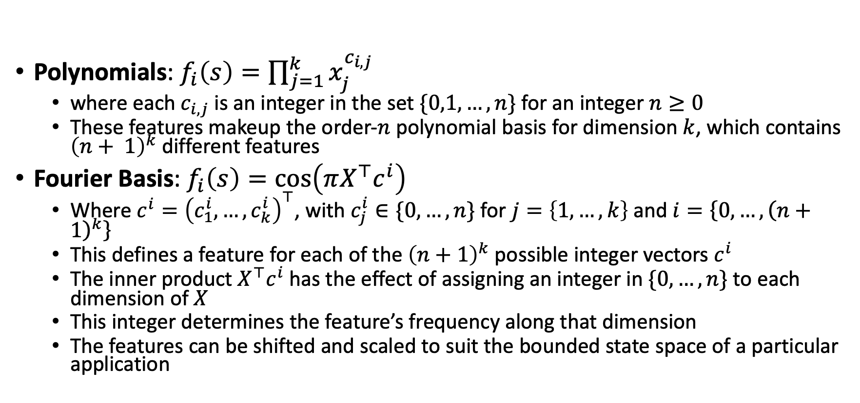
Automatic features extraction for linear approximator

Slide 26
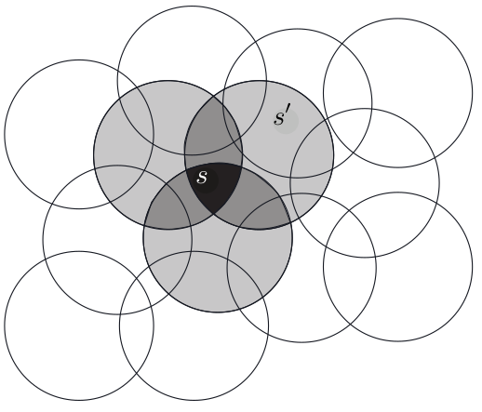
Automatic features extraction for linear approximator - Coarse Coding
Natural representation of the state set is continuous
In 2-d, features corresponding to circles in state space
Coding of a state:
If the state is inside a circle, then the corresponding feature has the value 1
otherwise the feature is 0
Corresponding to each circle is a single weight (a component of w) that is learned
Training a state affects the weights of all the intersecting circles.

Slide 27
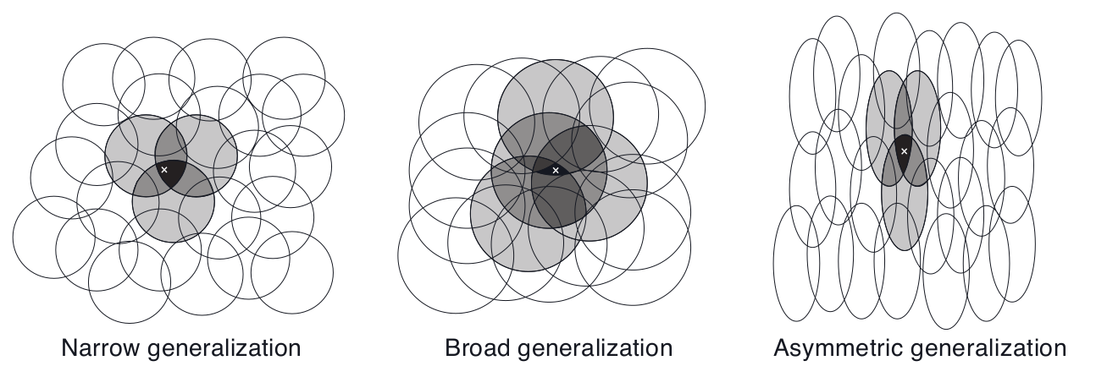
Automatic features extraction for linear approximator - Coarse Coding

Slide 28
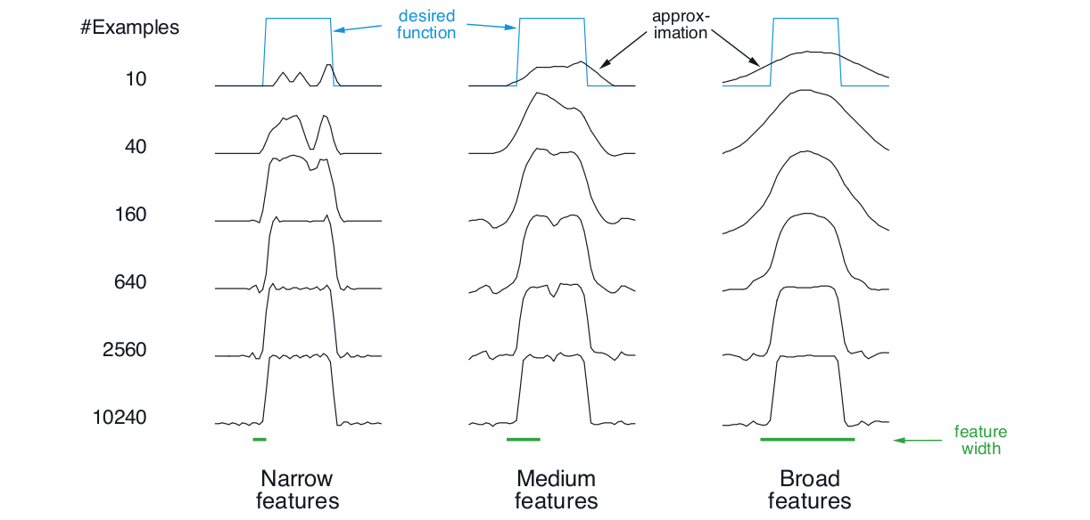
Automatic features extraction for linear approximator - Coarse Coding

Slide 29
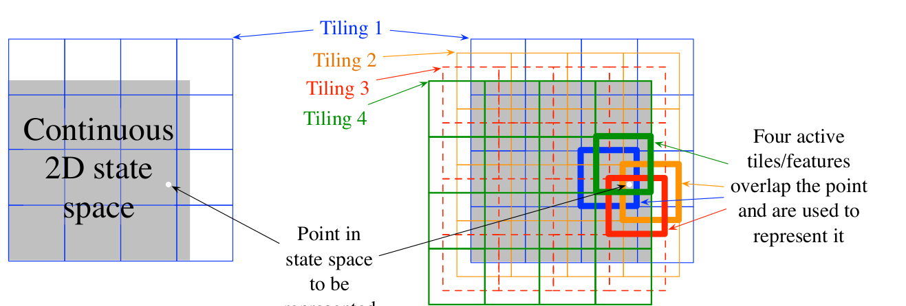
Automatic features extraction for linear approximator - Tile Coding

Slide 30
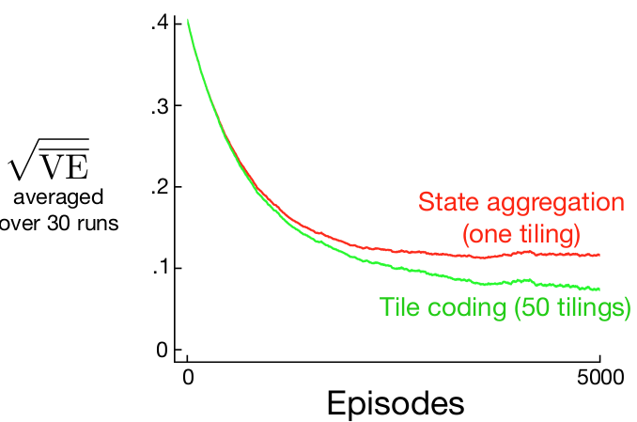
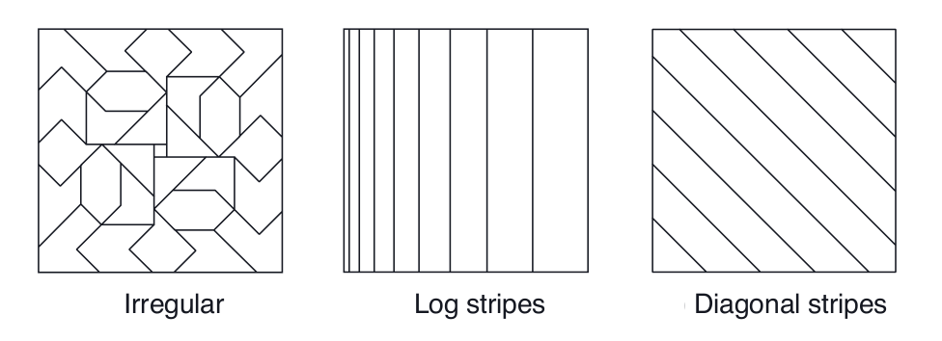
Automatic features extraction for linear approximator - Tile Coding

Slide 31
Automatic features extraction for linear approximator - Tile Coding

Slide 32
Automatic features extraction for linear approximator
Other approaches include: Coarse Coding, Tile Coding, Radial Basis Functions (See chapter 9.5 in textbook)
Each of these approaches defines a set of features, some useful yet most are not
E.g., is there a polynomial/Fourier function that translates pixels to pan location?
Probably but it’s a needle in a (combinatorial) haystack
Can we do better (generically)
Yes, using deep neural networks…

Slide 33
What did we learn?
Reinforcement learning must generalize on observed experience if it is to be applicable to real world domains
We can use parameterized function approximation to represent our knowledge about the domain state/action values
Use stochastic gradient descend to update the tunable parameters such that the observed (TD, rollout) error is reduced
When using a linear approximator, the Least squares TD method provides the most sample efficient approximation

Slide 34
Required Readings
Chapter-6 of Introduction to Reinforcement Learning,2nd Ed., Sutton & Barto

Slide 35
Thank you

